Slide 1





Approaches to Design
What, why, when?
Ideate
Virtual Lab
Visualization
GROUP 1:CREATIVE CATALYSTS
A.A ASWIN KUMAR
JOSHAN A
JASMINE KAUR AHLUWALIA
BHARGAVI GORTY
R DEEPIKA
5 minds

Slide 2

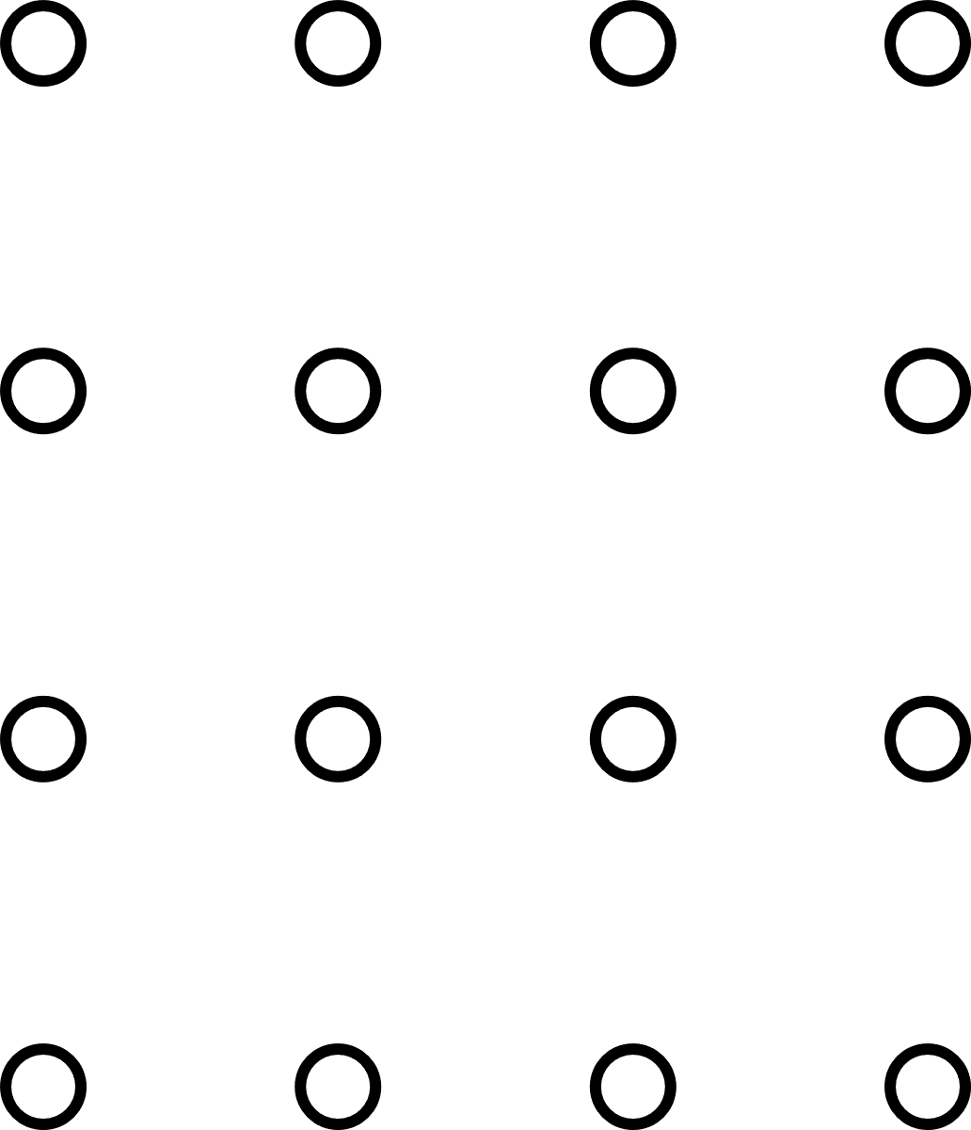
Our Project's Agenda
1
Conceptualization and Design of Virtual Lab Modules
2
Development of Simulation Models and Interactive Features
3
Testing, Validation, and User Feedback Collection
4
Final Deployment and Documentation

Slide 3
Introduction
Virtual Labs are digital platforms that simulate real-world experiments, enabling students to perform, observe, and analyze experiments remotely in a safe and flexible environment. They bridge the gap between theory and practice by offering interactive, scalable, and cost-effective solutions, especially where physical resources are limited. In the DTM project, Virtual Lab development focuses on modeling experiments accurately, creating interactive user interfaces, enabling data analysis, and promoting an accessible learning experience. This approach not only enhances technical and simulation skills but also supports modern, technology-driven education systems.

Slide 4
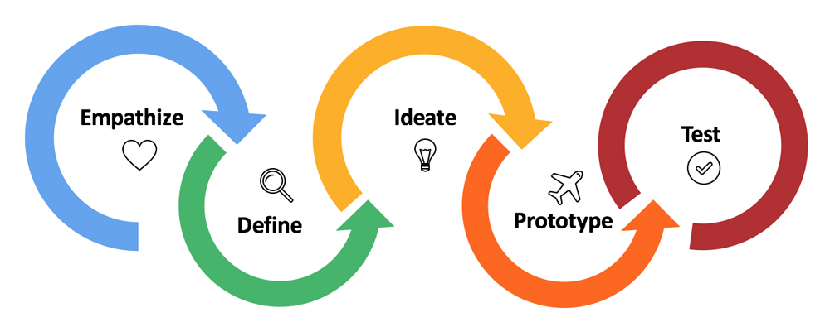
Design as a 5-step process
1
DEFINE
EMPATHIZE
IDEATE
PROTOTYPE
TEST
21
2
3
4
5

Slide 5
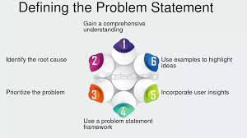
MDM Company
June 1, 2021
Define: Visualization of Actual Problem Statement
In this stage, we clearly defined and visualized the core problem: the lack of accessible, interactive experimental learning tools for chemistry students. Traditional labs are limited by resources, equipment availability, and safety concerns. Virtual Labs serve as a solution to overcome these limitations by offering simulations that are safe, scalable, and accessible anywhere.

Slide 6


Define: Persona
Description
Pains:
Virtual labs may not provide a truly realistic experience.
Fear of missing out on handling real equipment.
Gains:
Mistakes can be easily corrected in a virtual lab, reducing stress.
Accessible from the comfort of home, offering flexibility.
Jobs to be Done:
Needs expertise in chemical processes.
Requires hands-on practice, which virtual labs try to simulate.
Reality:
Karthick can attend virtual labs from anywhere.
A good internet connection is critical.
Virtual labs allow more flexibility with time management.
Stories and Observations:
When sick, Karthick could still keep up with lessons through virtual labs.
He practiced with other students online, which is not possible in traditional labs.
Concerns:
Poor internet connectivity hampers usage.
Suggestion: Virtual labs should offer offline access or a mobile app for convenience.
Name: Karthik
Age: 20 years
Location: Chennai, TN
Field: Chemical Engineering
Traits: Shy, average student

Slide 7




Journey Mapping
Empathy Mapping
Initial Phase:
User decides not to attend the physical lab.
Logs into the virtual lab after having some juice.
Mid Phase:
Encounters tough experiments causing a dip in user experience.
Messes up the dropping of chemicals, feeling frustrated.
Recovery Phase:
Realizes mistakes can be corrected.
Inputs correct values and feels satisfied after seeing the results.
Outcome: The journey captures emotional highs and lows as the user interacts with the virtual lab, eventually leading to a positive learning experience.
Say:
"It should be easy for beginners."
"It should be interactive and realistic."
"I need feedback over my steps."
Think:
"Will this help me understand properly?"
"How accurate are the simulations?"
"Will I get immediate results?"
Do:
Compares virtual lab with other platforms.
Compares results with physical lab outcomes.
Asks for feedback on performance.
Feel:
Happy due to less need for travel and great learning.
Irritated if server issues occur during learning.
Motivated when immediate feedback is provided.
3

Slide 8

Ideate: Brainstorming
We conducted idea generation sessions to list all possible solutions and features for the Virtual Labs. Ideas included animated simulations, step-by-step experiment guidance, live data plotting, quiz sections after experiments, and downloadable lab reports. All suggestions were listed without judgment for later evaluation.

Slide 9
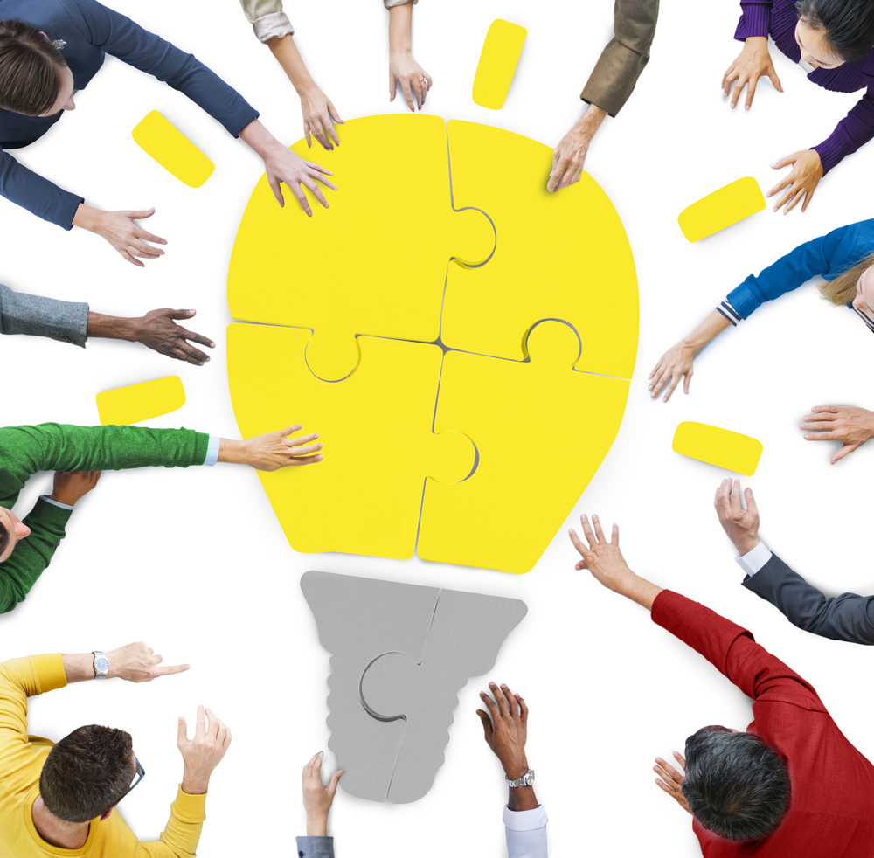
Ideate: Using Convergence
Brainstorm Area
Our Favorite Ideas
Use AI to get experimental Data
Use Python to develop v-lab
Provide Tutorials for beginners
Make it a course for experimental learning
Implement Reinforcement Learning
Provide Download Option
Add Industry related experiments
Provide peer reviewed submissions
Use Python to develop v-lab
Provide Tutorials for beginners
Implement Reinforcement Learning
Provide Download Option

Slide 10
Business Canvas Model
Key Partners
Key Activities
Key-Resources
Value Propositions
Educational Institutions
Cloud Storage
Website Maintenance
Marketing
Website Development
Scientific Content
Web Design
Coding
Free V-Lab
Paid Partnership

Slide 11
Business Canvas Model
Relationships
Channels
Customer-Segment
Cost Structure/ Revenue
Mass-Educators
Students
Experimenters
Website
Application
Students
Web users globally
Software Development
Advertisement
Subscriptions
Gadgets

Slide 12
That's a wrap!

